Slide 1
Deadlock William Stallings
Operating Systems (CS-2006) SPRING 2022, FAST NUCES
COURSE SUPERVISOR: ANAUM HAMID
anaum.hamid@nu.edu.pk

Slide 2
Deadlock
A set of processes is deadlocked, when each process in the set is blocked awaiting an event that can only be triggered by another blocked process in the set.
Typically involves processes competing for the same set of resources
No efficient solution
Notes:
A set of processes is deadlocked when each process in the set is blocked awaiting an event that can only be triggered by another blocked process in the set
typically processes are waiting the freeing up of some requested resource.
Deadlock is permanent because none of the events is ever triggered.
Unlike other problems in concurrent process management, there is no efficient solution in the general case.

Slide 3

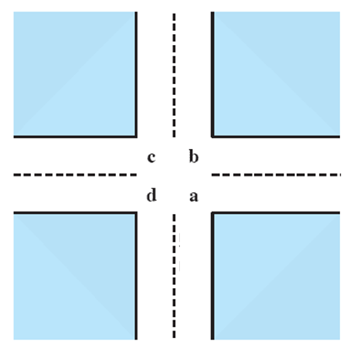
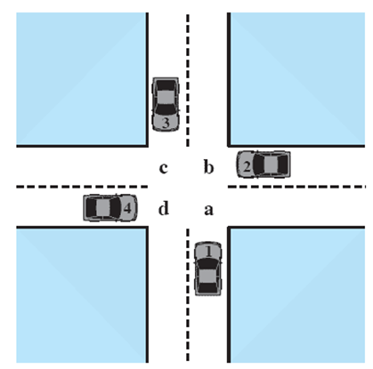



Potential Deadlock
I need quad C and B
I need quad B and C
I need quad A and B
I need quad D and A
Notes:
Animated Slide
Click 1 Cars approach intersection
Then Cars announce their resource needs
All deadlocks involve conflicting needs for resources by two or more processes. A common example is the traffic deadlock.
The typical rule of the road in the United States is that a car at a four-way stop should defer to a car immediately to its right.
This rule works if there are only two or three cars at the intersection.
If all four cars arrive at about the same time, each will refrain from entering the intersection, this causes a potential deadlock.
The deadlock is only potential, not actual, because the necessary resources are available for any of the cars to proceed.
If one car eventually does proceed, it can do so.

Slide 4
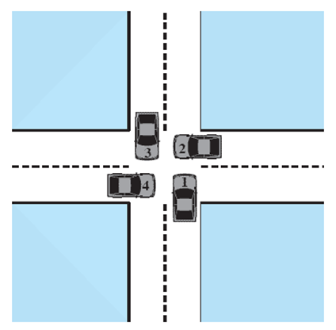
Actual Deadlock
HALT until D is free
HALT until C is free
HALT until B is free
HALT until A is free
Notes:
Animated Slide
Click 1 Cars move to deadlock
Then Cars announce their resource need
But if all four cars ignore the rules and proceed (cautiously) into the intersection at the same time, then each car seizes one resource (one quadrant) but cannot proceed because the required second resource has already been seized by another car.
This is an actual deadlock.

Slide 5
Conditions for possible Deadlock
Mutual exclusion (non-sharable resources)
Only one process may use a resource at a time
Hold-and-wait
A process may hold allocated resources while awaiting assignment of others
No pre-emption
No resource can be forcibly removed from a process holding it
Notes:
All three must be present for deadlock to occur.

Slide 6
Actual Deadlock Requires …
All previous 3 conditions plus:
Circular wait
A closed chain of processes exists, such that each process holds at least one resource needed by the next process in the chain.
Notes:
This is actually a potential consequence of the first three.
Given that the first three conditions exist, a sequence of events may occur that lead to an unresolvable circular wait.
The unresolvable circular wait is in fact the definition of deadlock.
The circular wait listed as condition 4 is unresolvable because the first three conditions hold.
Thus, the four conditions, taken together, constitute necessary and sufficient conditions for deadlock.

Slide 7
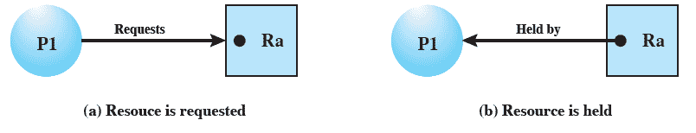
Resource Allocation Graphs
Directed graph that depicts a state of the system of resources and processes
Notes:
A graph edge directed from a process to a resource indicates a resource that has been requested by the process but not yet granted.
Within a resource node, a dot is shown for each instance of that resource.
A graph edge directed from a reusable resource node dot to a process indicates a request that has been granted

Slide 8
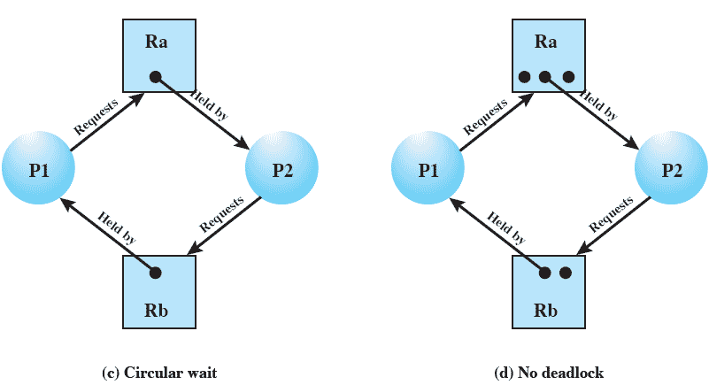
Resource Allocation Graphs of deadlock

Slide 9
Resource Allocation Graphs of deadlock
Deadlocks can be described more precisely in terms of a directed graph called a system resource-allocation graph

Slide 10
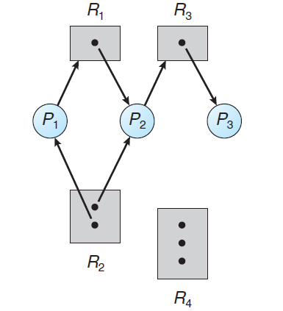
Resource Allocation Graphs of deadlock
Resource instances:
◦ One instance of resource type R1
◦ Two instances of resource type R2
◦ One instance of resource type R3
◦ Three instances of resource type R4
Process states:
◦ Process P1 is holding an instance of resource type R2 and is waiting for an instance of resource type R1.
◦ Process P2 is holding an instance of R1 and an instance of R2 and is waiting for an instance of R3.
◦ Process P3 is holding an instance of R3.

Slide 11
Resource Allocation Graphs of deadlock
P1
R1
P2
R2
P3
R3

Slide 12
RAG of Dinning Philosopher Problem
P1
held
F1
Req
P2
held
F2
Req
P3
held
F3
Req
P4
held
F4
Req
Req
P5
held
F5

Slide 13
Dealing with Deadlock
Three general approaches exist for dealing with deadlock.
Prevent deadlock
Avoid deadlock
Detect Deadlock
Notes:
Three general approaches exist for dealing with deadlock.
prevent deadlock
adopt a policy that eliminates one of the conditions (conditions 1 through 4).
avoid deadlock
by making the appropriate dynamic choices based on the current state of resource allocation.
detect the presence of deadlock
(conditions 1 through 4 hold) and take action to recover.
We discuss each of these approaches in turn.

Slide 14
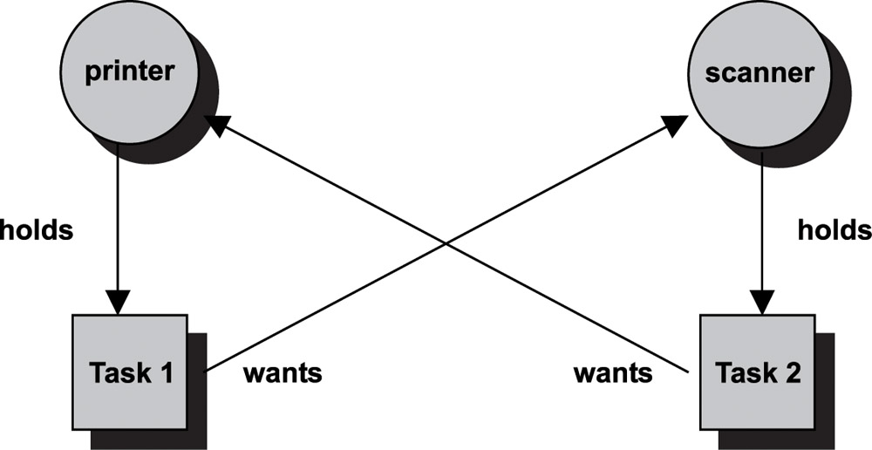
Dealing with Deadlock

Slide 15
Deadlock Prevention Strategy
Design a system in such a way that the possibility of deadlock is excluded.
Two main methods
Indirect – prevent one of the three necessary conditions from occurring
Direct – prevent circular waits
Notes:
Deadlock prevention is strategy simply to design a system in such a way that the possibility of deadlock is excluded.
We can view deadlock prevention methods as falling into two classes.
indirect method of deadlock prevention is to prevent the occurrence of one of the three necessary conditions listed previously (items 1 through 3).
direct method of deadlock prevention is to prevent the occurrence of a circular wait (item 4).
We now examine techniques related to each of the four
conditions.

Slide 16
Deadlock Prevention Conditions
Mutual Exclusion
Hold and Wait
No Preemption
Circular Wait
Notes:
Mutual Exclusion
The first of the four listed conditions cannot be disallowed (in general).
If access to a resource requires mutual exclusion, then mutual exclusion must be supported by the OS.
Some resources, such as files, may allow multiple accesses for reads but only exclusive access for writes.
Even in this case, deadlock can occur if more than one process requires write permission.
Hold an Wait
Can be prevented by requiring that a process request all of its required resources at one time and blocking the process until all requests can be granted simultaneously.
This approach is inefficient in two ways.
1) a process may be held up for a long time waiting for all of its resource requests to be filled, when in fact it could have proceeded with only some of the resources.
resources allocated to a process may remain unused for a considerable period, during which time they are denied to other processes.
Another problem is that a process may not know in advance all of the resources that it will require.
There is also the practical problem created by the use of modular programming or a multithreaded structure for an application.
An application would need to be aware of all resources that will be requested at all levels or in all modules to make the simultaneous request.

Slide 17
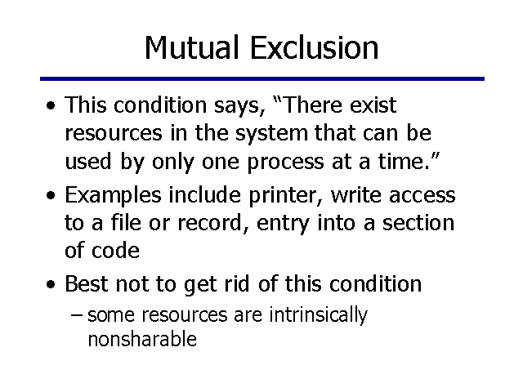
Deadlock Prevention Conditions

Slide 18
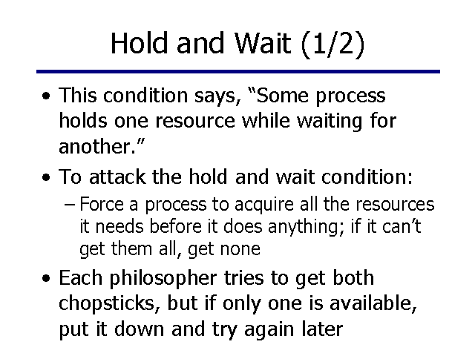
Deadlock Prevention Conditions

Slide 19
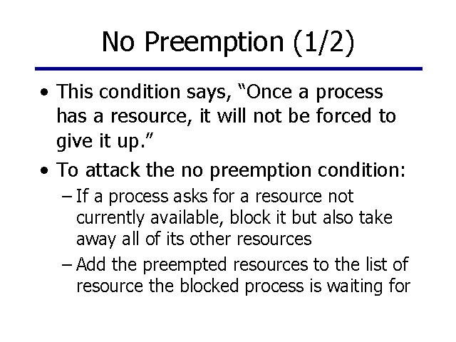
Deadlock Prevention Conditions

Slide 20
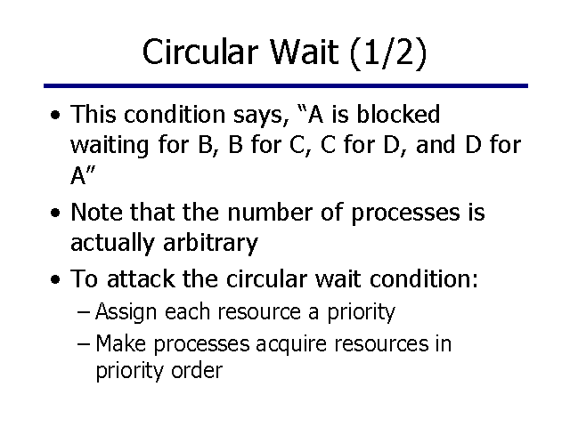
Deadlock Prevention Conditions

Slide 21
Deadlock Avoidance
A decision is made dynamically whether the current resource allocation request will, if granted, potentially lead to a deadlock
Requires knowledge of future process requests
Two Approaches to Deadlock Avoidance
Process Initiation Denial
Resource Allocation Denial
Notes:
Deadlock avoidance allows the three necessary conditions
but makes judicious choices to assure that the deadlock point is never reached.
Avoidance allows more concurrency than prevention.
With deadlock avoidance, a decision is made dynamically whether the current resource allocation request will, if granted, potentially lead to a deadlock.
Deadlock avoidance requires knowledge of future process resource requests.

Slide 22
Process Initiation Denial
A process is only started, if the maximum claim of all current processes plus those of the new process can be met.
Not optimal,
Assumes the worst: that all processes will make their maximum claims together.
Notes:
A process is only started if the maximum claim of all current processes plus those of the new process can be met.
This strategy is hardly optimal, because it assumes the worst:
that all processes will make their maximum claims together.

Slide 23
Resource Allocation Denial
Referred to as the banker’s algorithm
A strategy of resource allocation denial
Consider a system with fixed number of resources
State of the system is the current allocation of resources to process
Safe state is where there is at least one sequence that does not result in deadlock
Unsafe state is a state that is not safe
Notes:
Movie button goes to http://gaia.ecs.csus.edu/~zhangd/oscal/Banker/Banker.html

Slide 24
Basic Facts for deadlock avoidance
If a system is in safe state, ⇒ no deadlocks
If a system is in unsafe state ⇒ possibility of deadlock
Avoidance ⇒ ensure that a system will never enter an unsafe state.

Slide 25
Banker’s Algorithm
Multiple instances
Each process must a priori claim maximum use
When a process requests a resource, it may have to wait
When a process gets all its resources it must return them in a finite amount of time

Slide 26
Data Structures for the Banker’s Algorithm
Let n = number of processes, and m = number of resources types.
Available: Vector of length m. If available [j] = k, there are k instances of resource type R_{j} available
Max: n x m matrix. If Max [i,j] = k, then process P_{i} may request at most k instances of resource type R_{j}
Allocation: n x m matrix. If Allocation[i,j] = k then P_{i} is currently allocated k instances of R_{j}
Need: n x m matrix. If Need[i,j] = k, then P_{i} may need k more instances of R_{j} to complete its task
Need [i,j] = Max[i,j] – Allocation [i,j]

Slide 27
Safety Algorithm
1. Let Work and Finish be vectors of length m and n, respectively. Initialize:
Work = Available
Finish [i] = false for i = 0, 1, …, n- 1
2. Find an i such that both:
(a) Finish [i] = false
(b) Need_{i} ≤ Work
If no such i exists, go to step 4
3. Work = Work + Allocation_{i} Finish[i] = true go to step 2
4. If Finish [i] == true for all i, then the system is in a safe state

Slide 28
Example of Banker’s Algorithm
Discussed in Class

Slide 29
Resource-Request Algorithm for Process P_{i}
Request_{i} = request vector for process P_{i}. If Request_{i} [j] = k then process P_{i} wants k instances of resource type R_{j}
1. If Request_{i} ≤ Need_{i} go to step 2. Otherwise, raise error condition, since process has exceeded its maximum claim
2. If Request_{i} ≤ Available, go to step 3. Otherwise, P_{i} must wait, since resources are not available
3. Pretend to allocate requested resources to P_{i} by modifying the state as follows:
Available = Available – Request_{i};
Allocation_{i} = Allocation_{i} + Request_{i};
Need_{i} = Need_{i} – Request_{i};
If safe ⇒ the resources are allocated to P_{i}
If unsafe ⇒ P_{i} must wait, and the old resource-allocation state is restored

Slide 30
Example of Resource Request Algorithm
Discussed in Class

Slide 31
Deadlock Detection
Allow system to enter deadlock state
Detection algorithm
Recovery scheme

Slide 32
Single Instance of Each Resource Type
Maintain wait-for graph
Nodes are processes
P_{i} → P_{j} if P_{i} is waiting for P_{j}
Periodically invoke an algorithm that searches for a cycle in the graph. If there is a cycle, there exists a deadlock
An algorithm to detect a cycle in a graph requires an order of n² operations, where n is the number of vertices in the graph

Slide 33
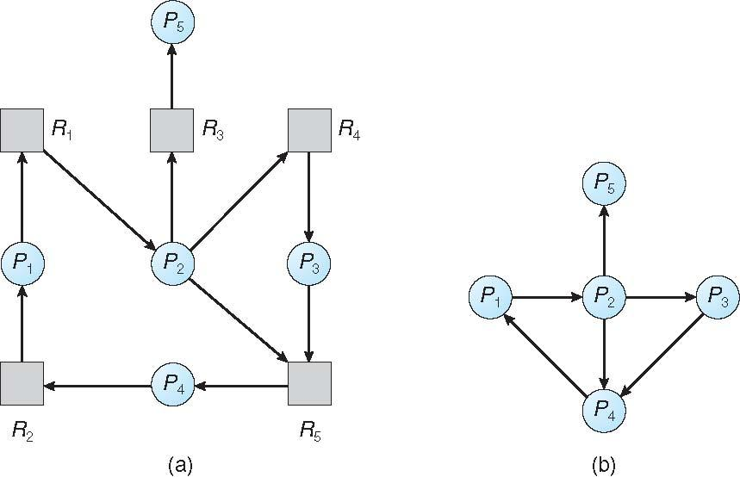
Resource-Allocation Graph and Wait-for Graph
Resource-Allocation Graph
Corresponding wait-for graph

Slide 34
Detection Algorithm
1. Let Work and Finish be vectors of length m and n, respectively Initialize:
(a) Work = Available
(b) For i = 1,2, …, n, if Allocation_{i} ≠ 0, then Finish[i] = false; otherwise, Finish[i] = true
2. Find an index i such that both:
(a) Finish[i] == false
(b) Request_{i} ≤ Work
If no such i exists, go to step 4

Slide 35
Detection Algorithm (Cont.)
3. Work = Work + Allocation_{i} Finish[i] = true go to step 2
4. If Finish[i] == false, for some i, 1 ≤ i ≤ n, then the system is in deadlock state. Moreover, if Finish[i] == false, then P_{i} is deadlocked

Slide 36
Example of Detection Algorithm
Five processes P₀ through P₄; three resource types A (7 instances), B (2 instances), and C (6 instances)
Snapshot at time T₀:
Allocation Request Available
A B C A B C A B C
P₀ 0 1 0 0 0 0 0 0 0
P₁ 2 0 0 2 0 2 3 1 3
P₂ 3 0 3 0 0 0 5 2 4
P₃ 2 1 1 1 0 0
P₄ 0 0 2 0 0 2
Sequence <P₀, P₂, P₃, P₁, P₄> will result in Finish[i] = true for all i

Slide 37
Example (Cont.)
P₂ requests an additional instance of type C
Request
A B C
P₀ 0 0 0
P₁ 2 0 2
P₂ 0 0 1
P₃ 1 0 0
P₄ 0 0 2
State of system?
Can reclaim resources held by process P₀, but insufficient resources to fulfill other processes; requests
Deadlock exists, consisting of processes P₁, P₂, P₃, and P₄

Slide 38
Recovery from Deadlock: Process Termination
Abort all deadlocked processes
Abort one process at a time until the deadlock cycle is eliminated
In which order should we choose to abort?
Priority of the process
How long process has computed, and how much longer to completion
Resources the process has used
Resources process needs to complete
How many processes will need to be terminated
Is process interactive or batch?

Slide 39
Recovery from Deadlock: Resource Preemption
Selecting a victim – minimize cost
Rollback – return to some safe state, restart process for that state
Starvation – same process may always be picked as victim, include number of rollback in cost factor

Slide 40
Thank You!

